Slide 1
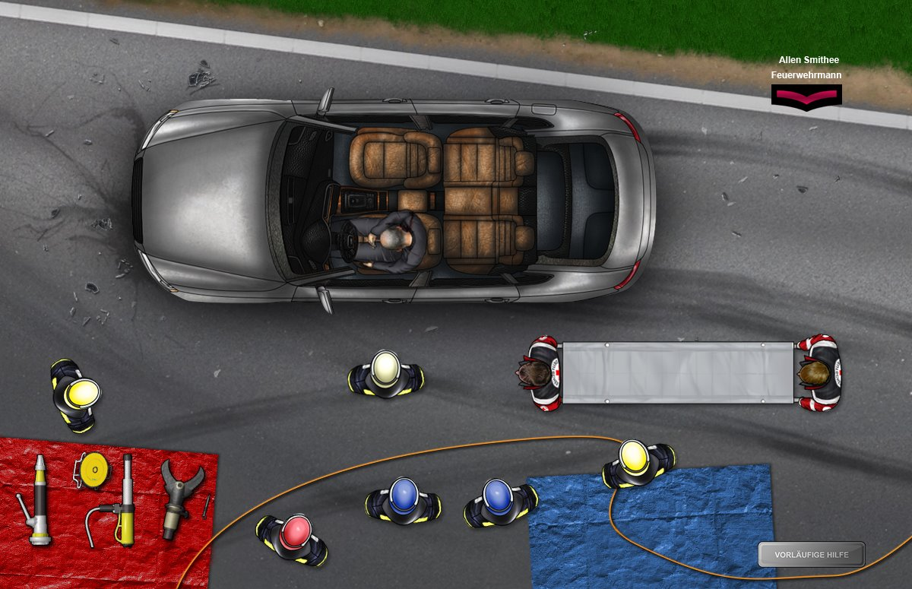
Advanced Steels Workarounds
Mike Smith
BoronExtrication.com

Slide 2
Module Objectives
Add new techniques to the mental toolbox.
Learn different advanced steel workarounds.
Identify the importance of having a Plan B &C.
Learn about new low-cost hand tools to assist rescuers performing workarounds.

Slide 3
Advanced Steel Extrication
Locate the patient, locate the most suitable opening and determine the tactics necessary to clear a path between the two.

Slide 4
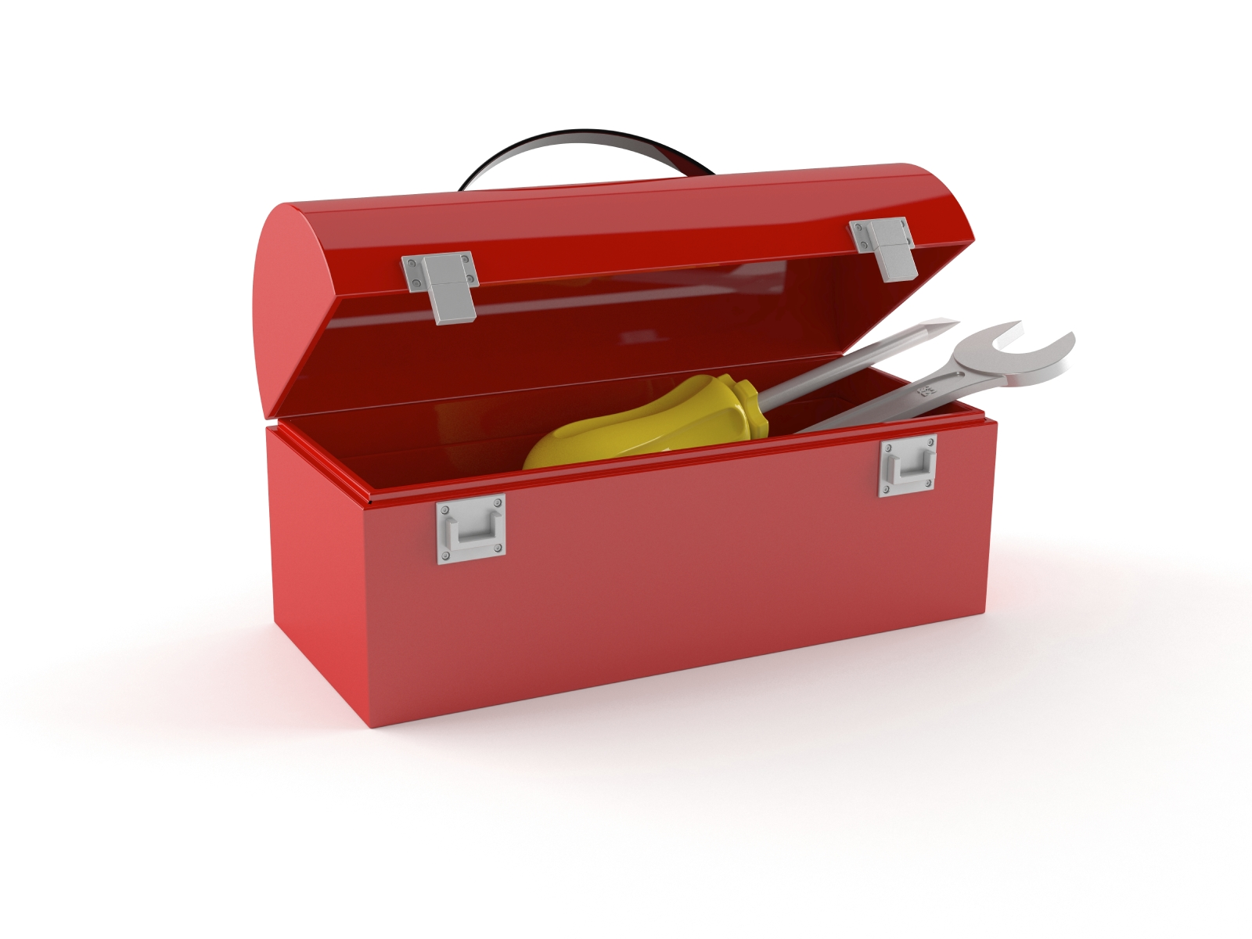
Mental Toolbox
?

Slide 5
Adding to the Mental Toolbox
As trainers, our students need to understand the importance of adding tips and techniques to their mental toolboxes.
Firefighters formulate a mental plan while responding to a run.
Students need to have that plan b and c tucked in their mental toolbox.
The core principles of extrication have remained largely unchanged.

Slide 6
Distorting
To change the shape of an object in a plastic flow manner or other manner without severing or parting.
Examples of distorting are bending, prying, spreading, enlarging, expanding, squeezing, compressing

Slide 7
Displacing
The moving of an object or a portion of an object from its original position. The motion may be in any plane and the effect of the force applied is generally controllable. Minor distortion may occur during displacing

Slide 8
Disassembling
Reducing objects to basic component parts in the reverse manner from which originally assembled.

Slide 9
Severing
To divide into two or more parts by cutting, piercing, penetrating, splitting, breaking, sawing

Slide 10
Tips and Techniques
Tool placement
Cutting a b-pillar with advanced steel is more successful when the cutter is parallel to the side doors.
If the cutters stall during a cut, keep the trigger completely open for at least 10 seconds before stopping to allow the pressure to build.

Slide 11
Advanced Steels Workarounds
Ram Roof Off B-Pillar
Pie Cut
Pillar to Pillar
Lift B-Pillar Up
Ram Roof Off B-Pillar
Trunk Tunneling
Dash & Instrument Panel Movement

Slide 12
Spreading B-Pillar to B-Pillar
Spread with a tool such as a power ram from B-pillar to B-pillar to simulate moving a crash-damaged pillar off of a driver trapped inside.
The seatbacks can obstruct this spreading effort and many teams have power rams but they may not extend far enough to reach from one B-pillar to the other.
Monitor roof movement as it may begin to lower into the vehicle as the B-pillars move outward.

Slide 13
Spreading Center Tunnel To B-Pillar
Spread the B-pillar away from the interior of the vehicle as if it had been pushed inward during a side impact.
Only work pushing or spreading tool on half of the vehicle; from the floorboard center tunnel area to the passenger's side B-pillar.

Slide 14
Lifting B-Pillar Up
Cut the B-pillar at the bottom, lift it up and away from the simulated trapped patient. The patient doesn't care if you lay the B-pillar down or lift the B-pillar up; they just want out.

Slide 15
Ram the Roof Off
When a rescue team cannot cut through a B-pillar or roof rail that contains advanced steel, a good "work-around" technique can be to ram the roof off the top of the B-pillar. Even though advanced steel may be present, a powerful ram may be able to push the roof rail up until it begins to tear free at the spot welds.
The assigned team must place additional cribbing beneath the rocker to support the force of the ram. After an initial push on one side of the B-pillar, a second push on the opposite side may be enough to completely tear the B-pillar away from the roof rail in a real-world situation. Once separated from the roof, the crew must practice bending the pillar down without making any additional cuts. It simulates not being able to cut the bottom of the pillar in a real-world scenario.

Slide 16
Pie Cut
Inverted V-pattern cuts into the roof rail, bypassing the B-Pillar and basically cutting around it.
With cutters that have smaller blades two pie cuts will need to be made on each side of the B-Pillar and then a cut parallel to the side of the vehicle to free the top of the B-Pillar

Slide 17
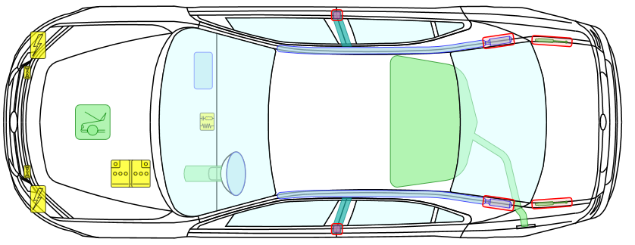
Pie Cut

Slide 18
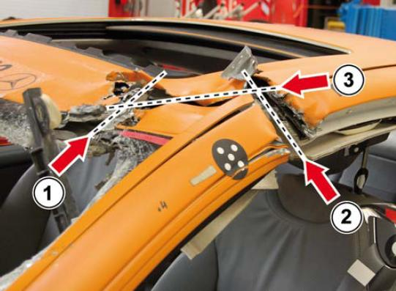

Slide 19
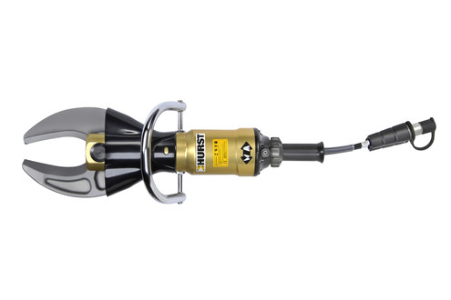
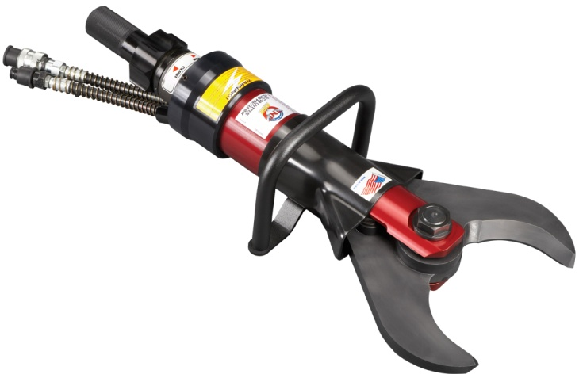
Pie Cut Tip

Slide 20
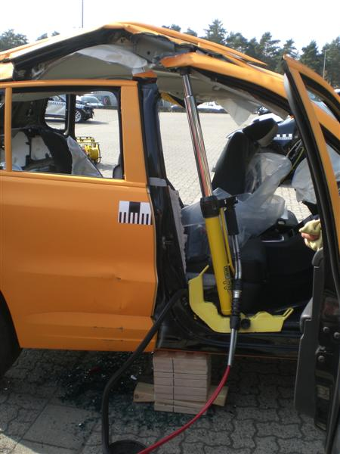
Ram Roof Off B-Pillar
Use Ram to spread against roofline until spot welds tear apart.
Remember, the weld is the weakest link.

Slide 21
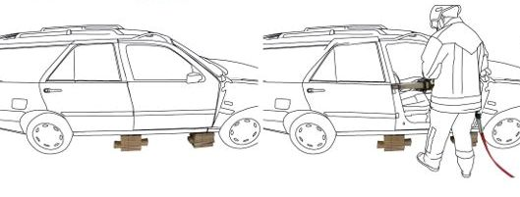
Ram Roof Off B-Pillar

Slide 22
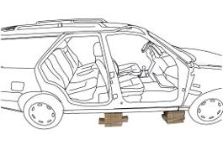
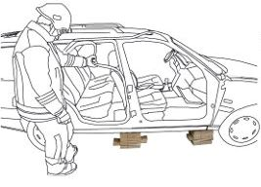
Ram Roof Off B-Pillar

Slide 23
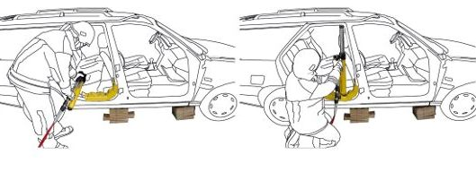
Ram Roof Off B-Pillar

Slide 24
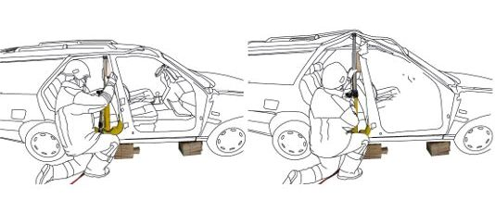
Ram Roof Off B-Pillar

Slide 25
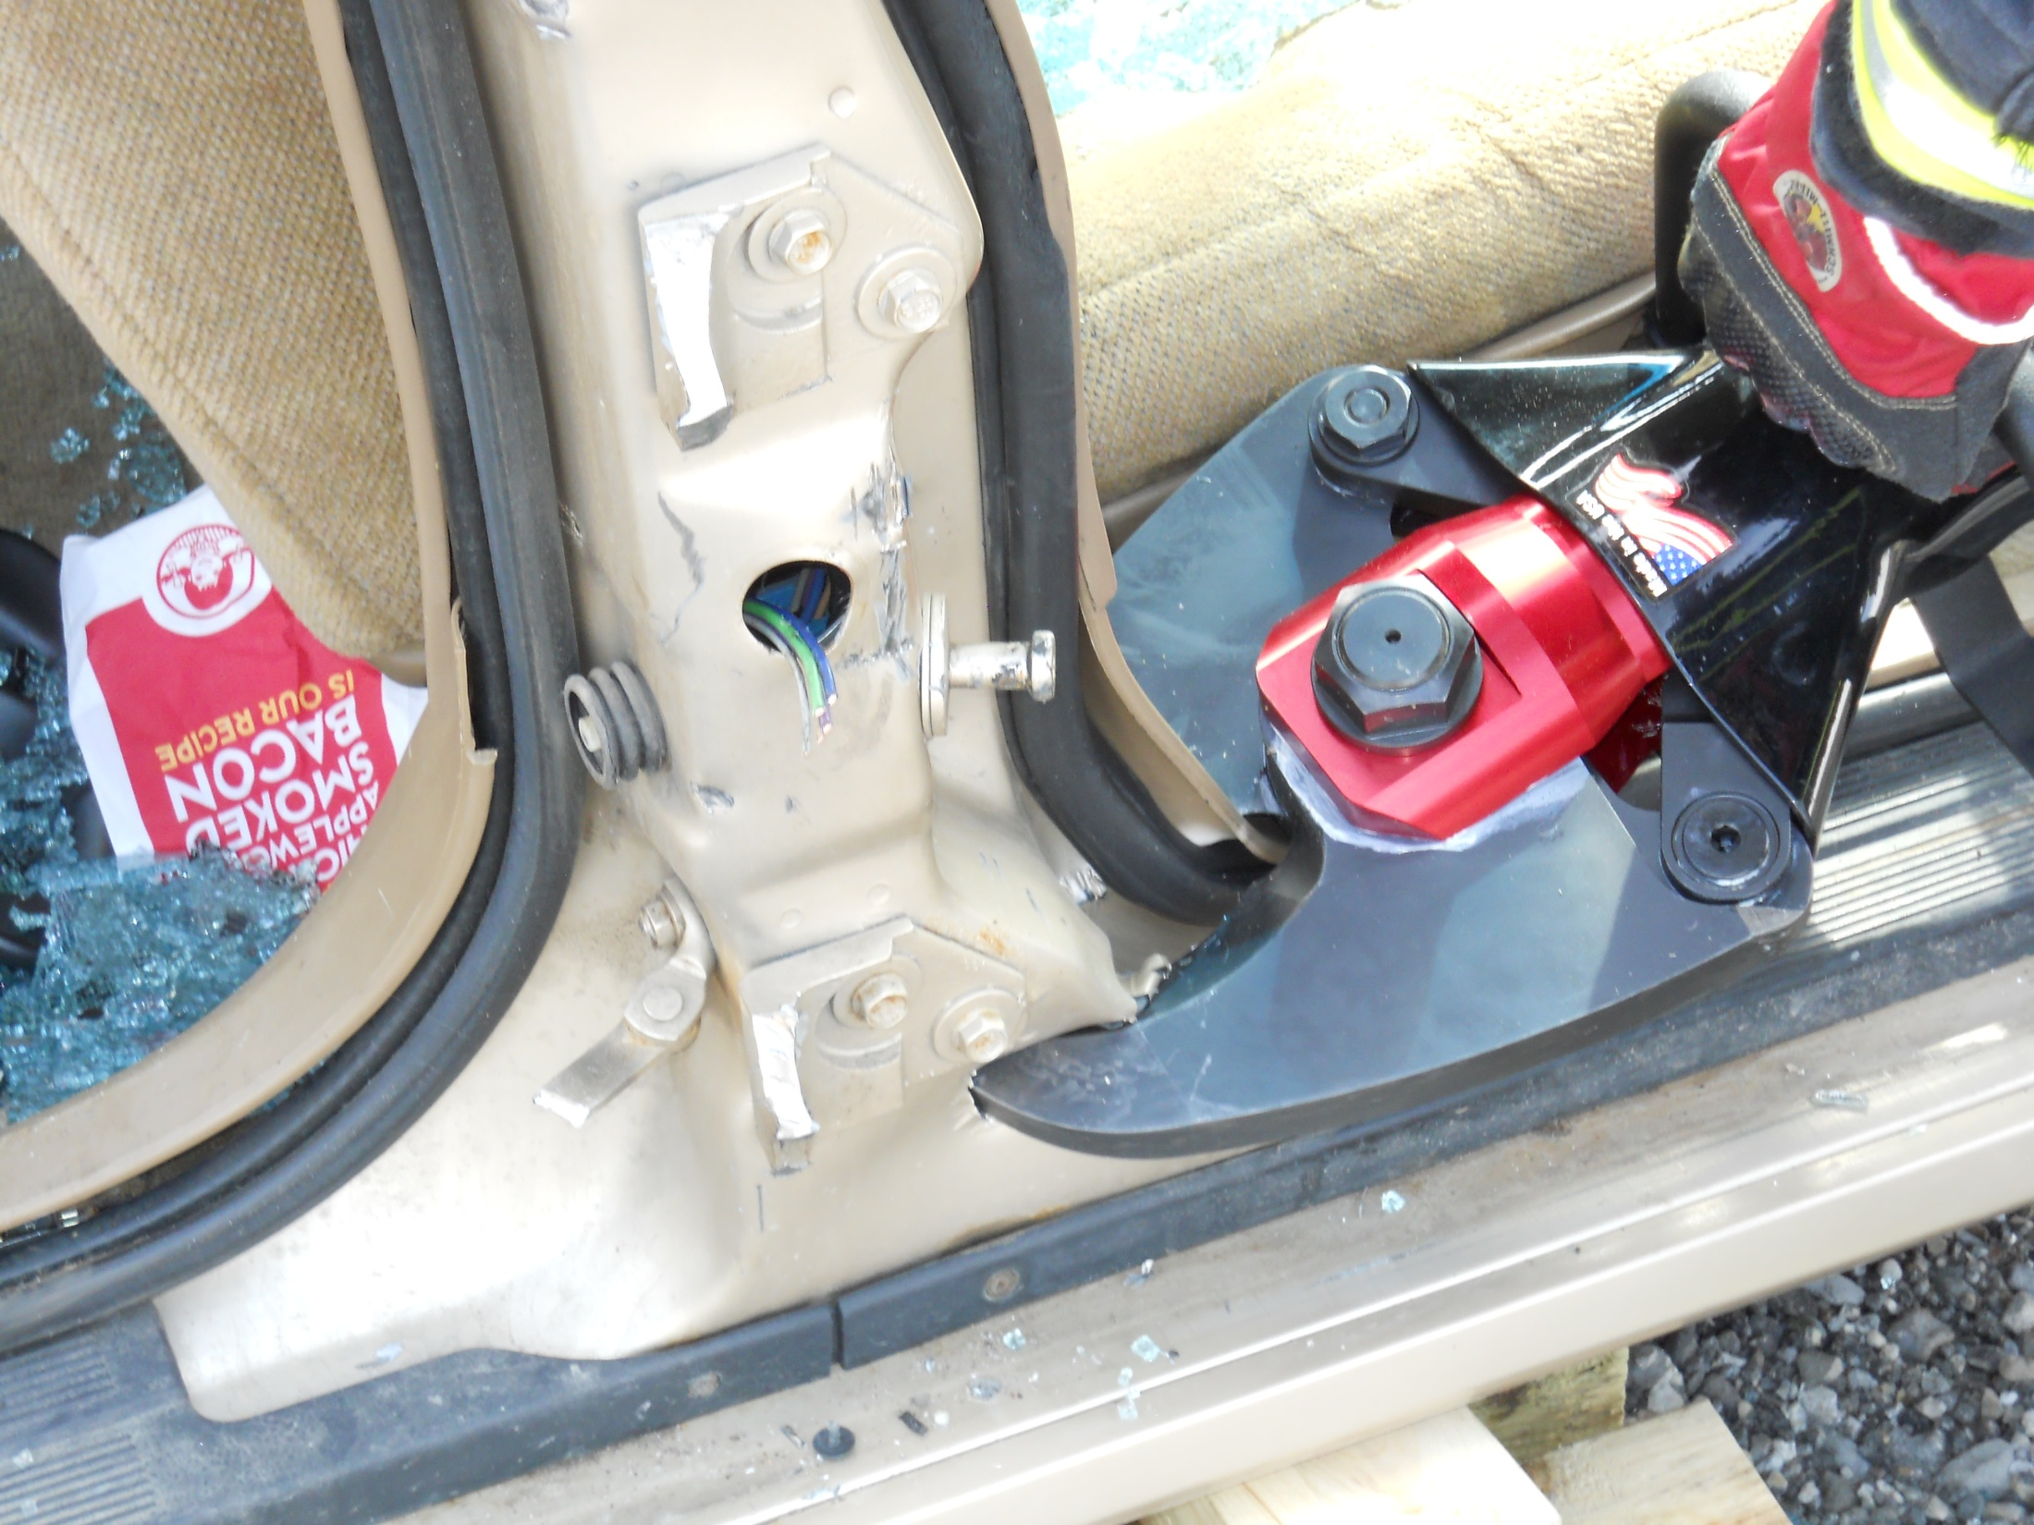
Lay down the B-Pillar

Slide 26
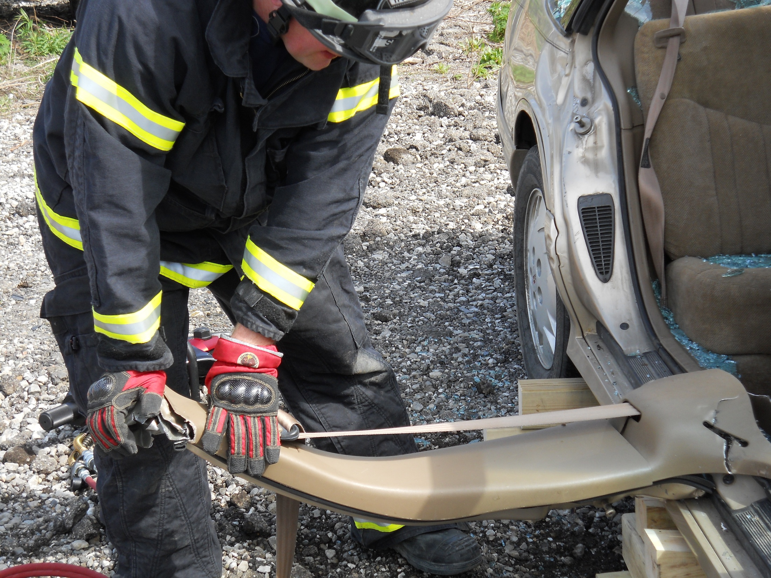
Lay down the B-Pillar

Slide 27
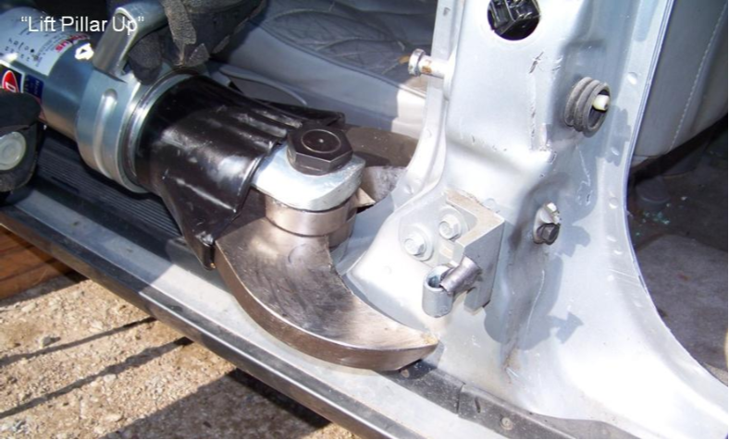
Lift B-Pillar Up

Slide 28
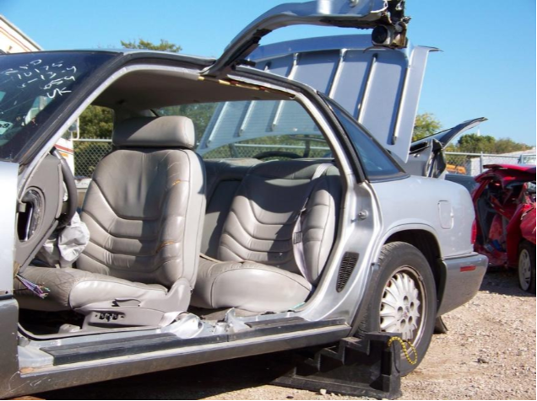
Lift B-Pillar Up

Slide 29
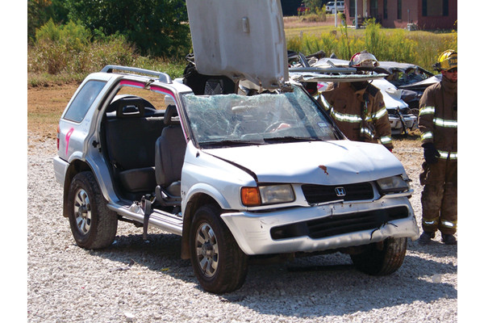
Total Sunroof

Slide 30
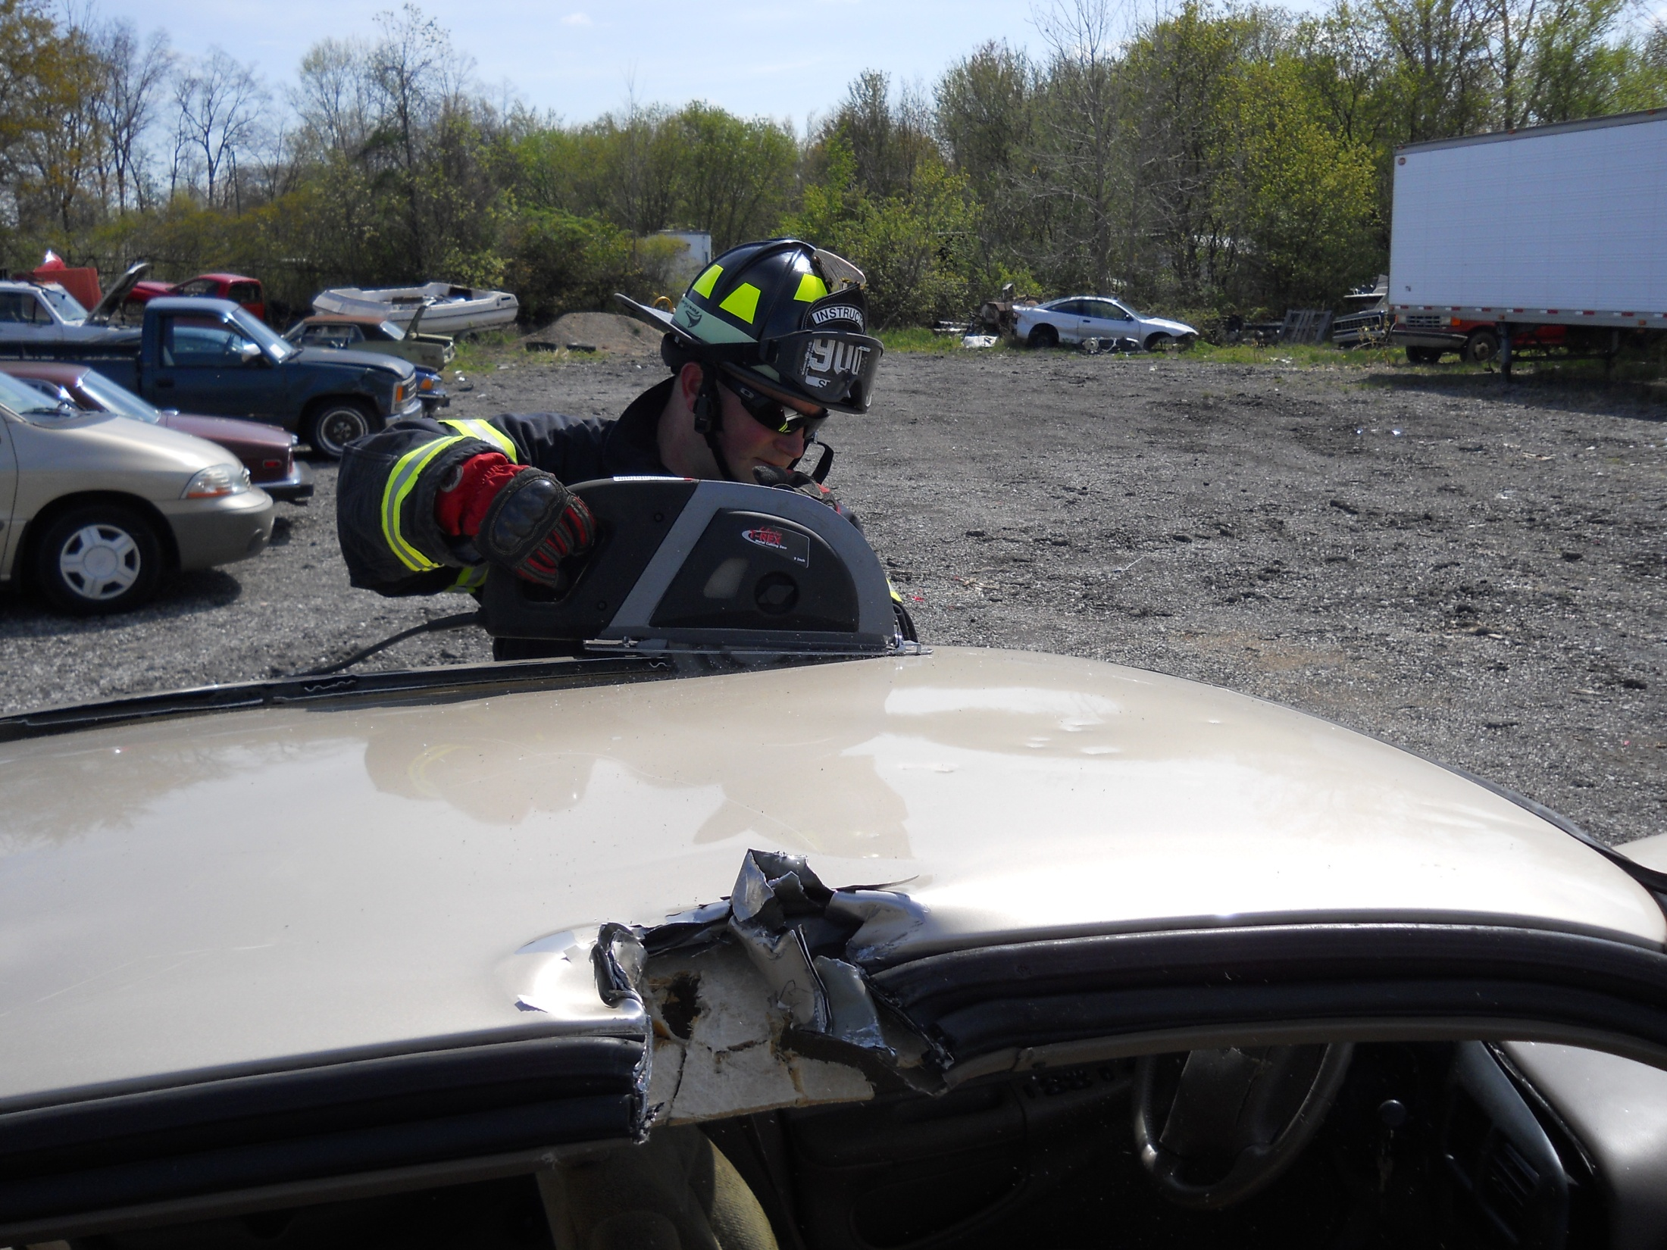

Slide 31
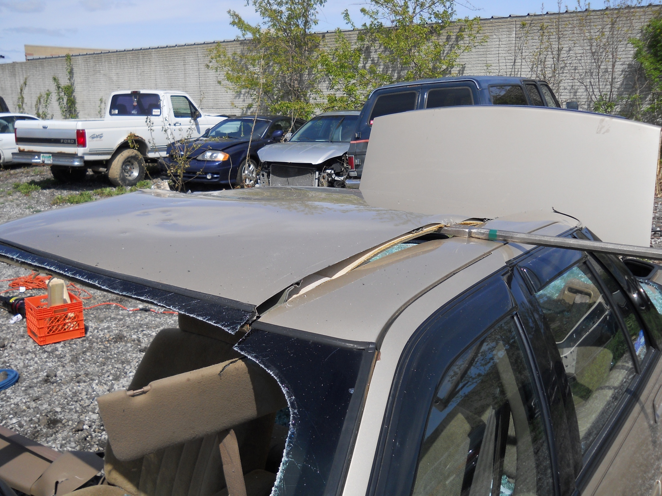

Slide 32
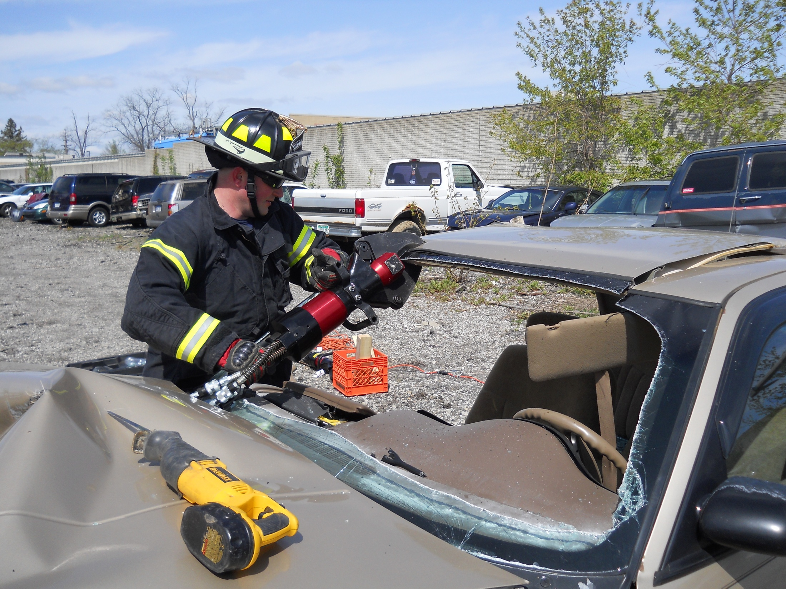

Slide 33
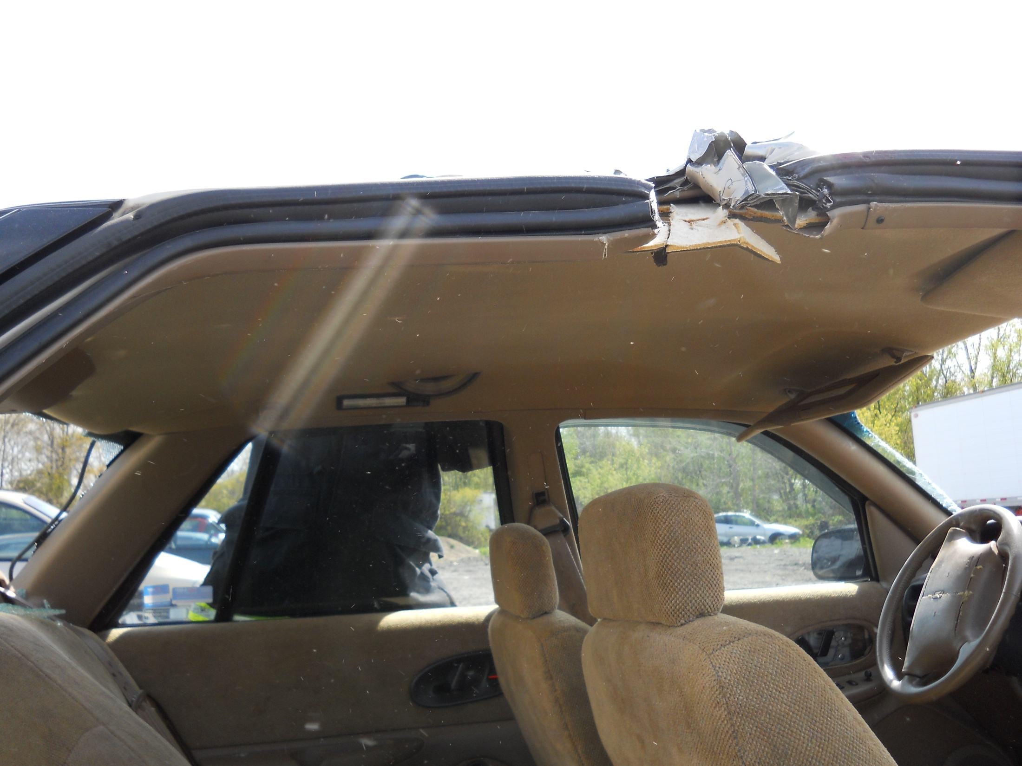

Slide 34
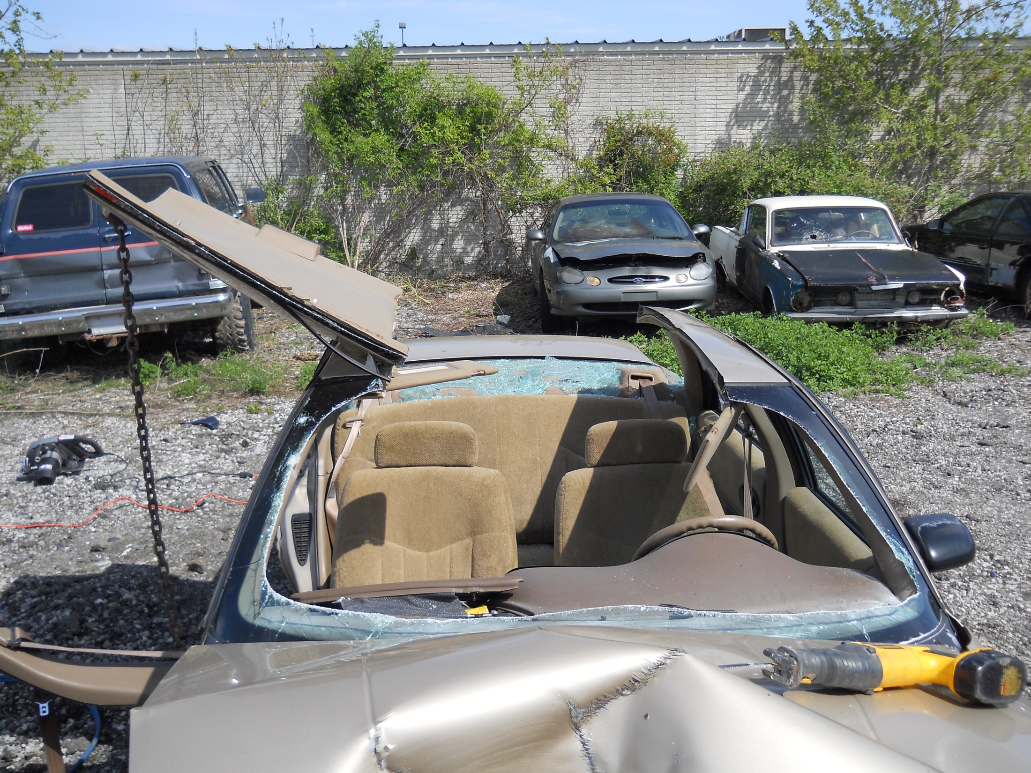

Slide 35
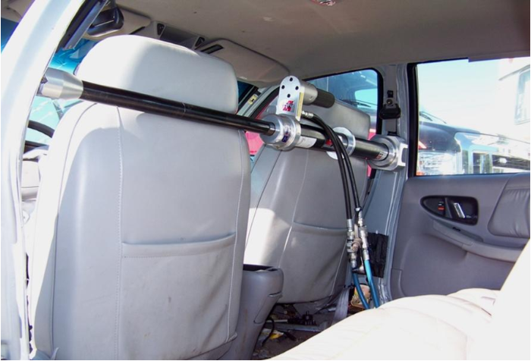
Cross Ram

Slide 36
Cross Ram Tips
If the vehicle is rear-wheel drive you can try to ram off the transmission hump in the middle of the floorboard by inserting the base of a short ram against the hump and the tip against the B-pillar. In using this method you may find it hard to get a good bite if the angle is too great, which may cause the tip to slip out when extending the ram.

Slide 37
Trunk Tunneling
Stabilize the car
Remove rear glass
Open and remove trunk
Remove rear bulkhead
Get rescuer in and manipulate or remove seatback
Slide longboard in and use strap around chest to pull pt out while inside rescuer maintains c-spine.
Inside rescuer can also use spreader to lift dash by pushing off center hump if needed.
Also tried pulling seatback down using chain and come-along from rear bumper and it worked pretty well.

Slide 38
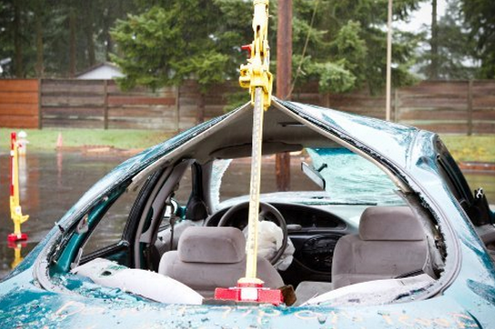
Trunk Tunneling

Slide 39
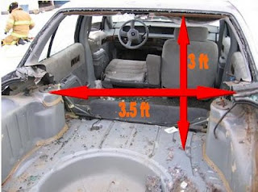
Trunk Tunneling

Slide 40
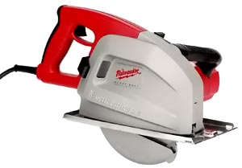
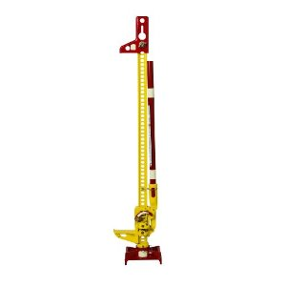
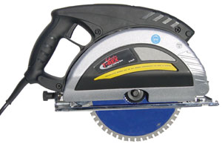
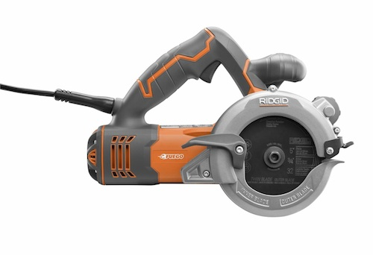
New Tools

Slide 41
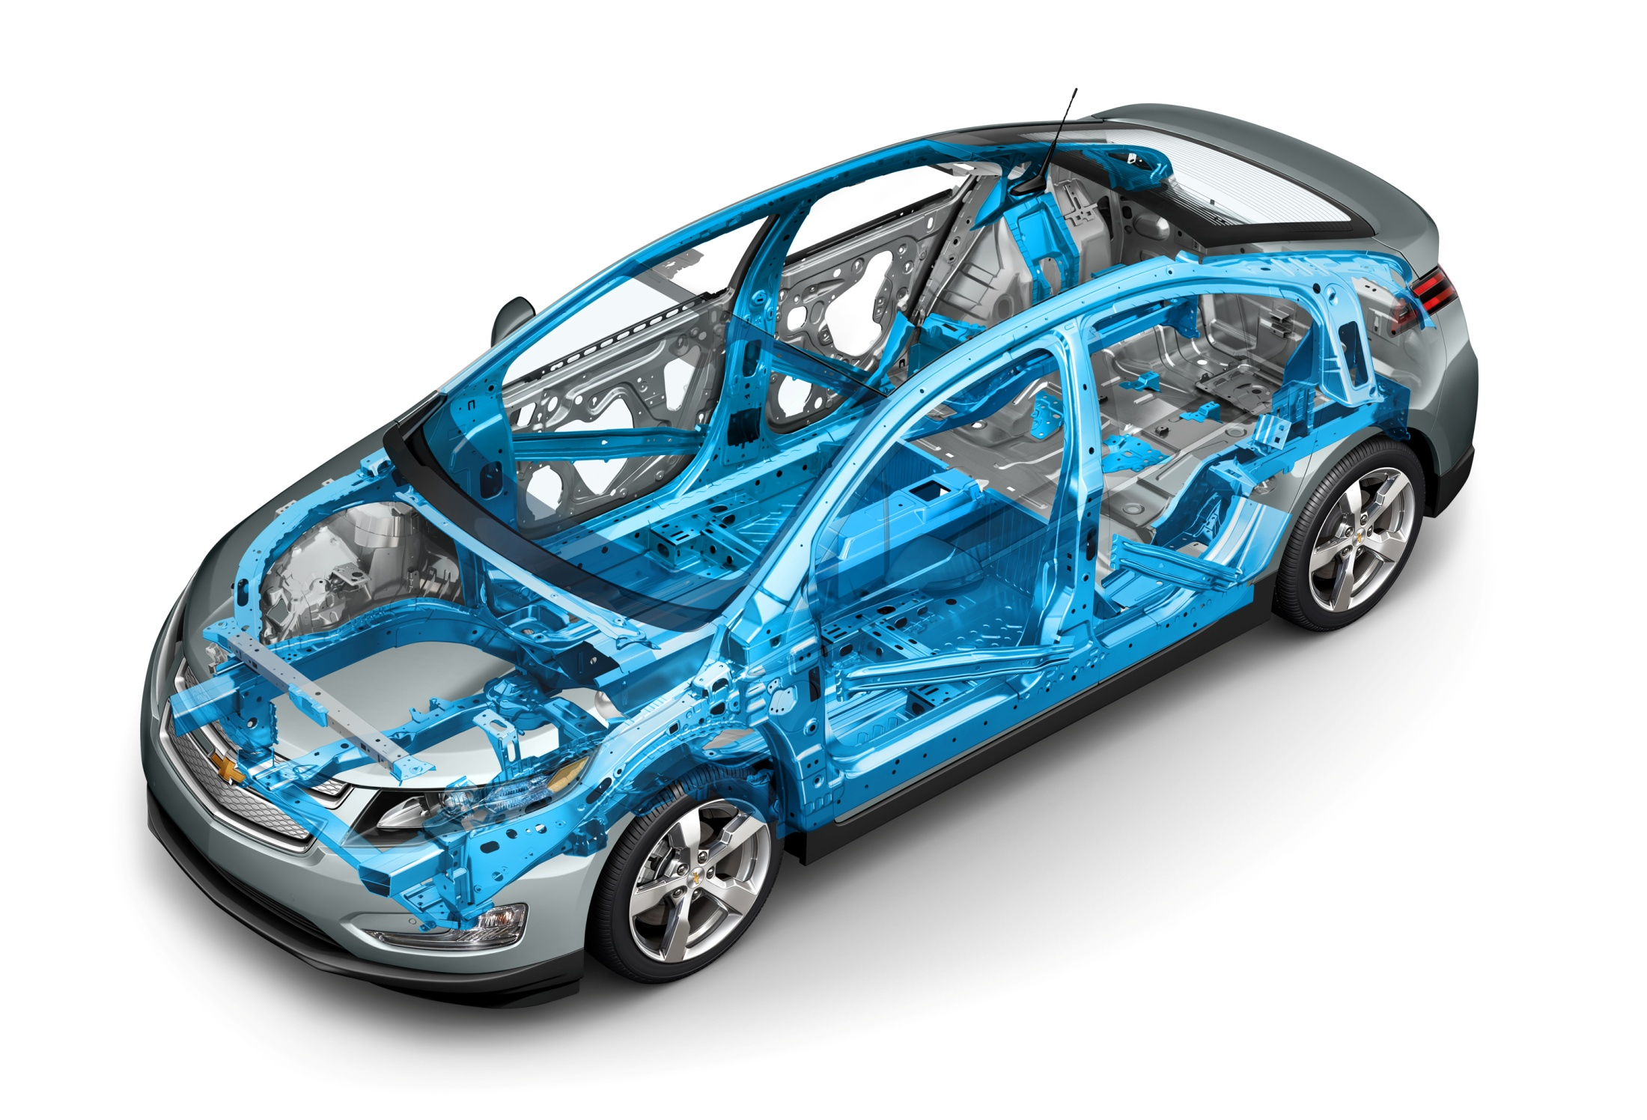

Slide 42
Traditional or Non-Traditional
Rescuers must be well versed in traditional and non-traditional tactics to successfully extricate victims. Never underestimate the potential of developing a path of egress between patients and existing openings. Find an opening, push parts back into their original positions and clear the path.

Slide 43
Questions?

